Slide 1
Backpack Awareness
A Collaboration between the PTSA & LWSD
Notes:
goal:share what we’ve done and invite your school to participate

Slide 2
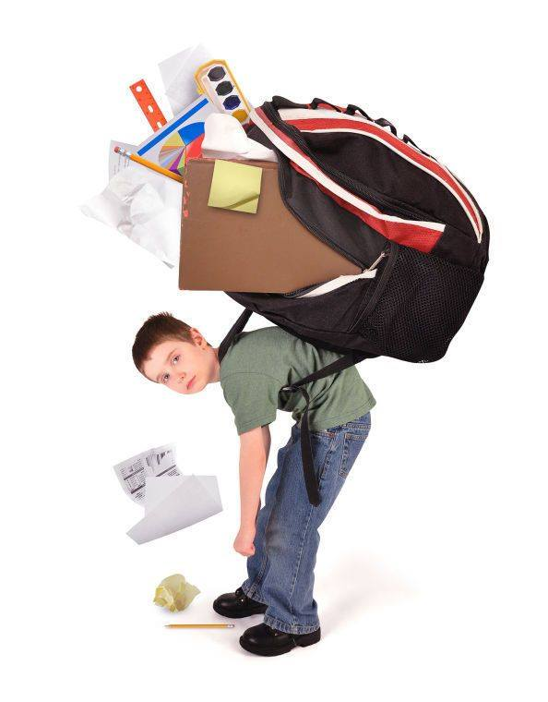
Notes:
Why is this important? Some kids carrying 1/3 of their wt (45 pounds for me) Growing Bodies not designed. Impacts on posture- out of alignment. Most disparity in middle school kids (size vs expected loads to carry)

Slide 3
Kirkland Middle School: Backpack Committee
Started Spring 2015
Parent Concern
Backpack Awareness Day
Problem Scoped, Solutions Identified
Presented to LWSD Spring 2016
Why is this important?
Gained Dr. Pierce’s support
AOTA: “A backpack should not weigh more than 10-15% of student’s bodyweight”
Notes:
National BPA Day (AOTA)- Kids have fun! platform for edu and gathering data, relevant sample size, 16.1 lbs avg in 2015

Slide 4
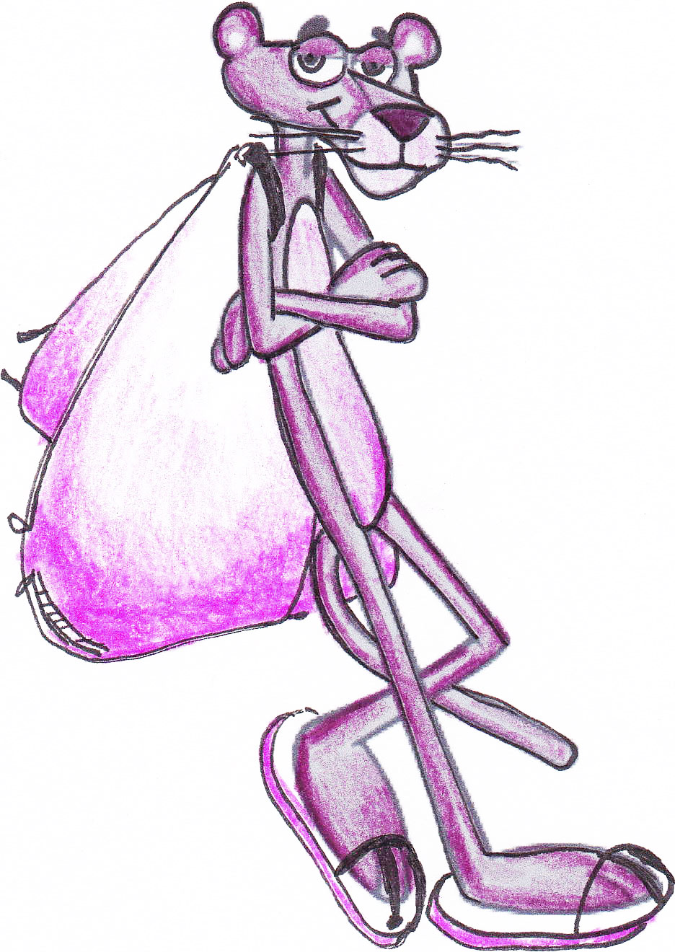
Working in Partnership
Committee meets with LWSD every other month
Review goals and ideas
Short term
Long term
Celebrate Successes
KiMS has shed 1.5 pounds from ‘15 to ‘16
Notes:
Cultivating relationship, district would like more faces at the table

Slide 5
Successes to Date
Kirk Elementary 5th graders were provided education on Backpack awareness by committee volunteers
KiMS committee met with KiMS students and staff for ideas
Education materials were made available by the committee to KiMS students, parents and staff
KiMS created a new, lighter supply list for 2016-17
2016-17 student planner reduced in weight/size
KiMS Math department de-spined workbooks, and used lighter plastic binders
Backpack clean-outs were implemented at KiMS
KiMS/LWSD added 2 water filling stations at school so students won’t need to carry full bottles to school
Teachers at KiMS provided more storage in some classrooms to reduce what students had to carry
LWSD Communications Department initiated “Pack it light, check at night” campaign on social media and in district publications targeting parents, students and staff
“Tips for Purchasing a Backpack” from AOTA was posted on LWSD Website and Social Media
LWSD Principals were provided with article and resources to share in newsletters
LWSD Communications Department provided poster masters for use at schools
At the 2016 KiMS weigh-in, the average backpack was reduced to 14.6 pounds from 16.1 in 2015
Notes:
Just a visual slide of how much has been done, will highlight one or two of these

Slide 6
Broadening the Scope District-Wide
Share what we’ve learned
Utilize district level support
Two Years of Work
Ongoing/continuous effort
Improvement over time
Need more voices at the table
Backpack Awareness Day at your School
Consistency in process
Is backpack weight a concern at your school?
Notes:
No silver bullet solution/ talk to parents, principal, Each school is unique

Slide 7
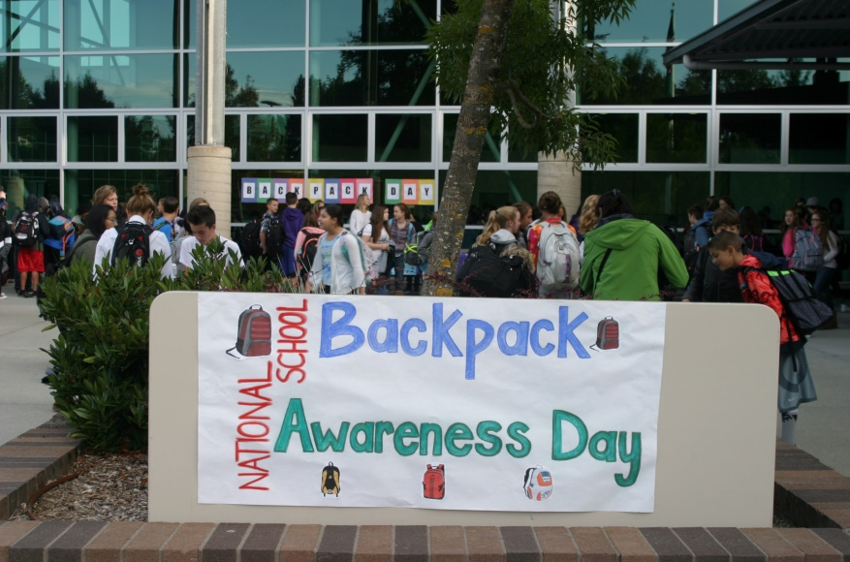
Backpack Awareness Day Workshop
Tuesday, May 9th 10-11:30am
Redmond Public Library -Conference Room, 15990 NE 85th St., Redmond
How to Sign up and RSVP:
Email: backpack@kirklandptsa.org
Include school name, attendee names
Notes:
RSVP and encourage to join, email if you can’t make it but would like more info/materials

